Slide 1
podcast website
K. David Pearce
Student Project
MSSA San Antonio Cohort 5

Slide 2
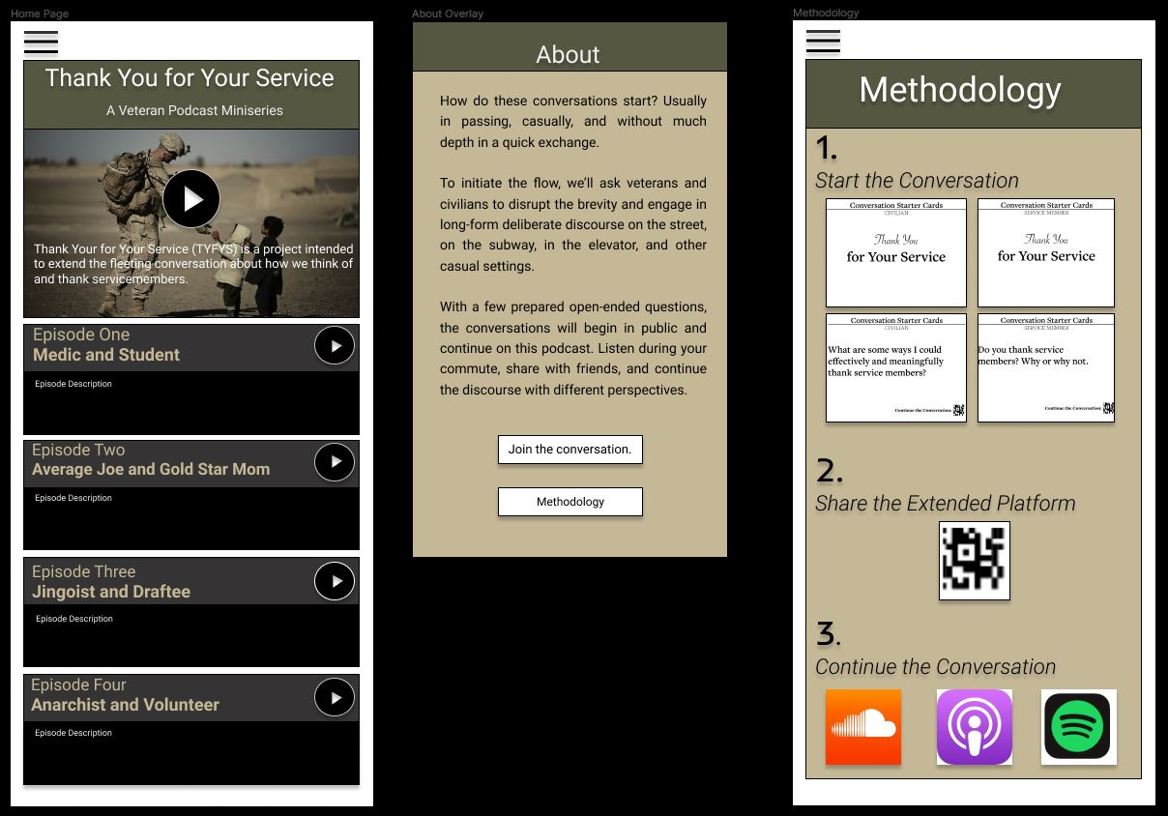
Purpose
My wife wants to create a podcast titled “Thank You For Your Service” that extends the fleeting conversation between veterans and civilians about how we think of and thank service members
She designed a prototype of the website (see left image) using a website called Figma
The website will host her podcasts and will also have an online store where fans can purchase things like shirts and coffee mugs

Slide 3
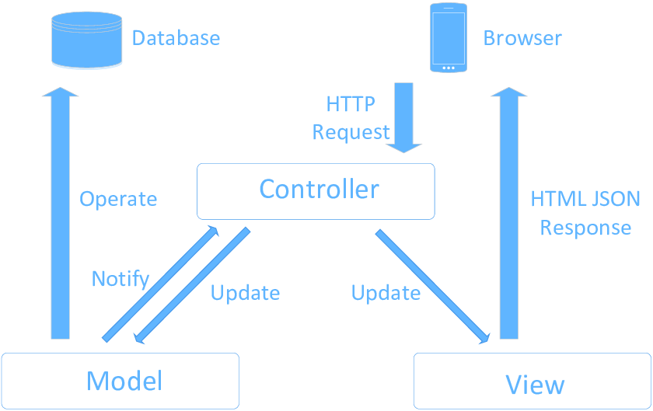
Functional requirements
The user will click a button on the website to listen to a podcast episode
The browser will send an HTTP request to the Controller
The Controller will access the Model which retrieves the correct episode from the database
The controller will then access the View which sends the HTML response back to the browser

Slide 4
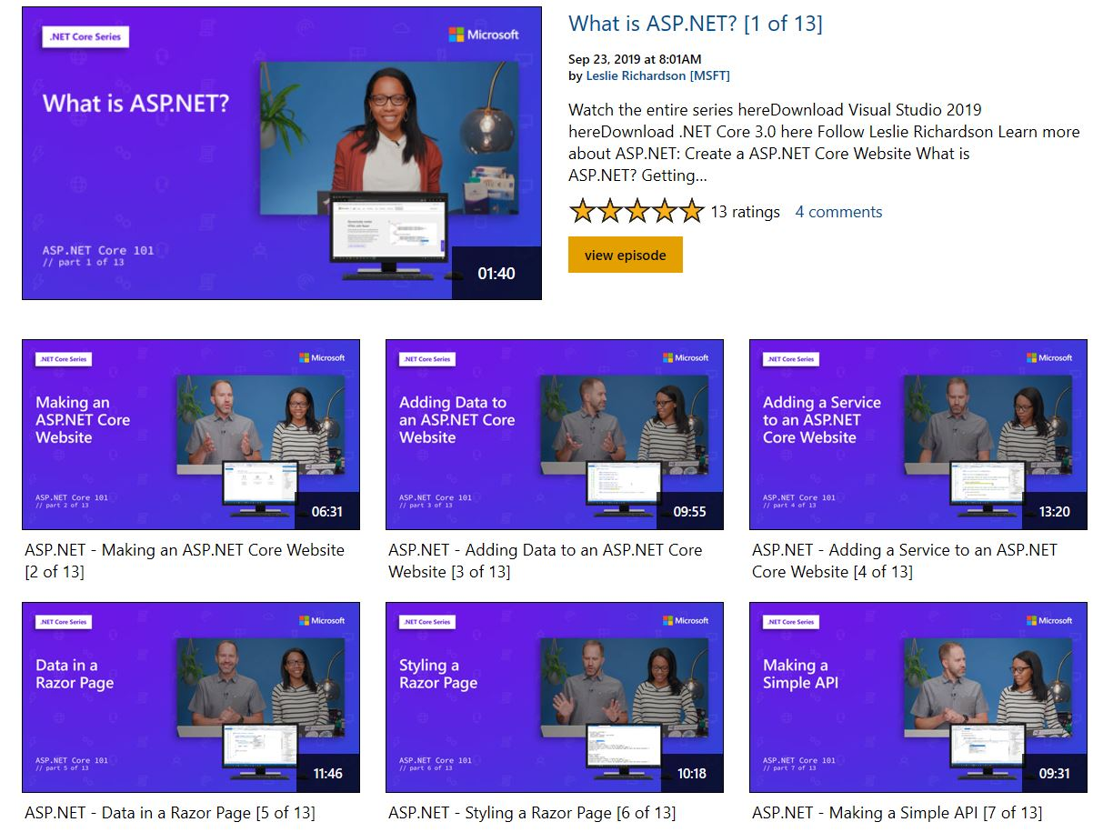
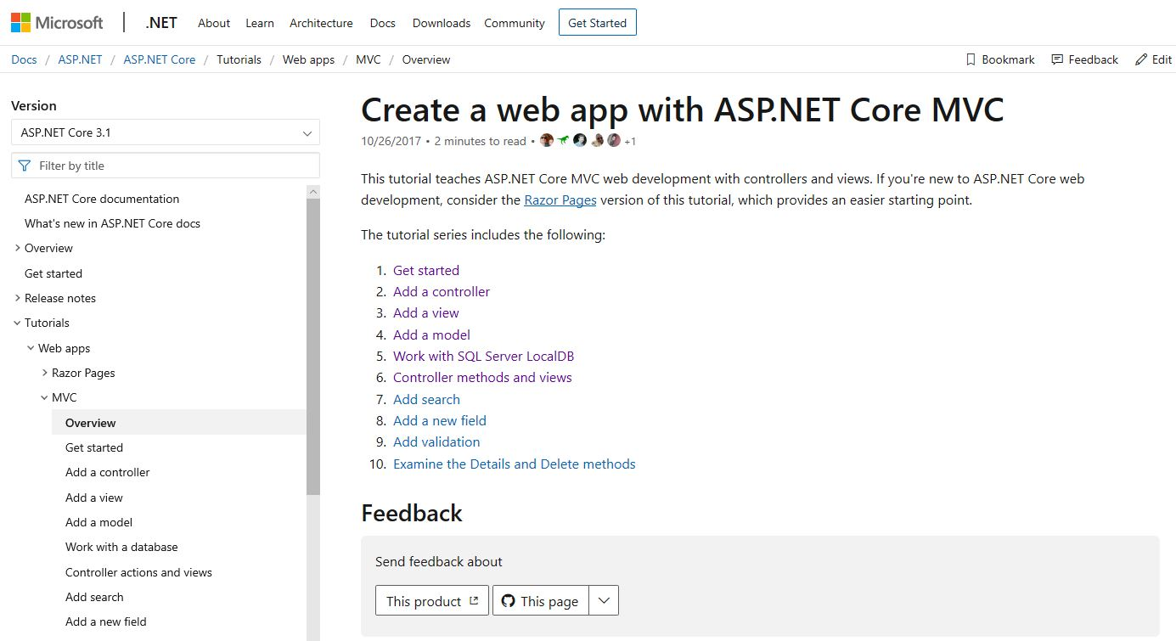
Literature to assist me (part 1)
I will use two websites to assist me in creating the website:
First is the ASP.NET tutorial website (left)
Second is the ASP.NET example (right)

Slide 5
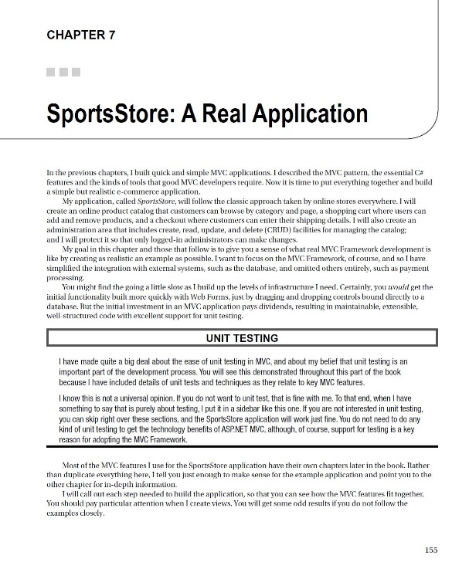
Literature to assist me (part 2)
I will also be referencing Chapter 7 of the MVC Core textbook in order to setup the online store
The textbook uses a Sports Store as an example, and I will tailor the details to reflect a Podcast Store

Slide 6
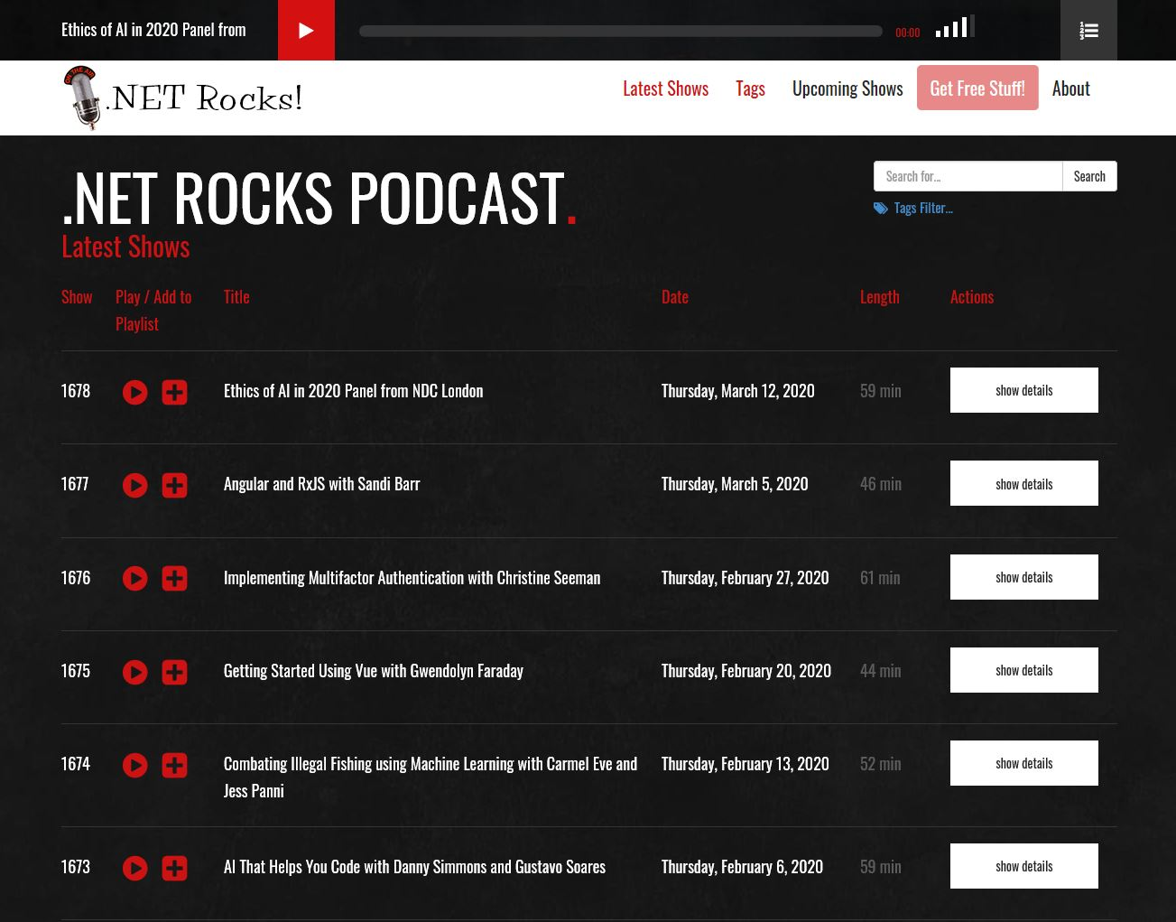
Example podcast website
An example podcast website would look like the photo on the left
At the top would be a button to play the current episode
On the bottom would be additional buttons to play previous episodes
The menu bar would have links to the “About” page and the “Store” page

Slide 7
Project plan
Step 1: Create a new ASP.NET Core Web Application project
Step 2: Add Controllers, Views, and Model
Step 3: Link to a database
Step 4: Add content
Step 5: Use Razor, HTML, and CSS to improve the user interface
Step 6: Publish website using Azure

Slide 8
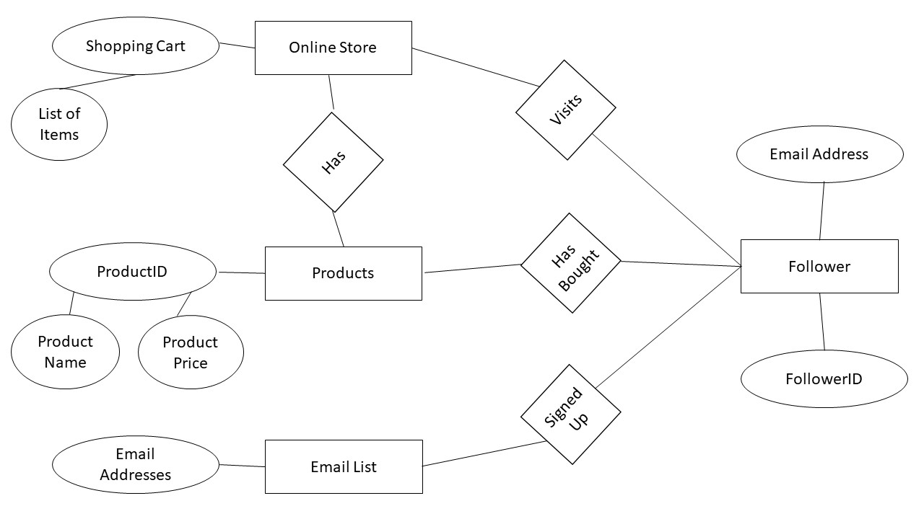
Information architecture
My original idea for the information architecture was very basic
A follower of the podcast could create an account by signing up for the email list
The follower could also visit the online store and fill their shopping cart with items
The online store would be linked to a products table that contained information pertaining to all of the products that we sell

Slide 9
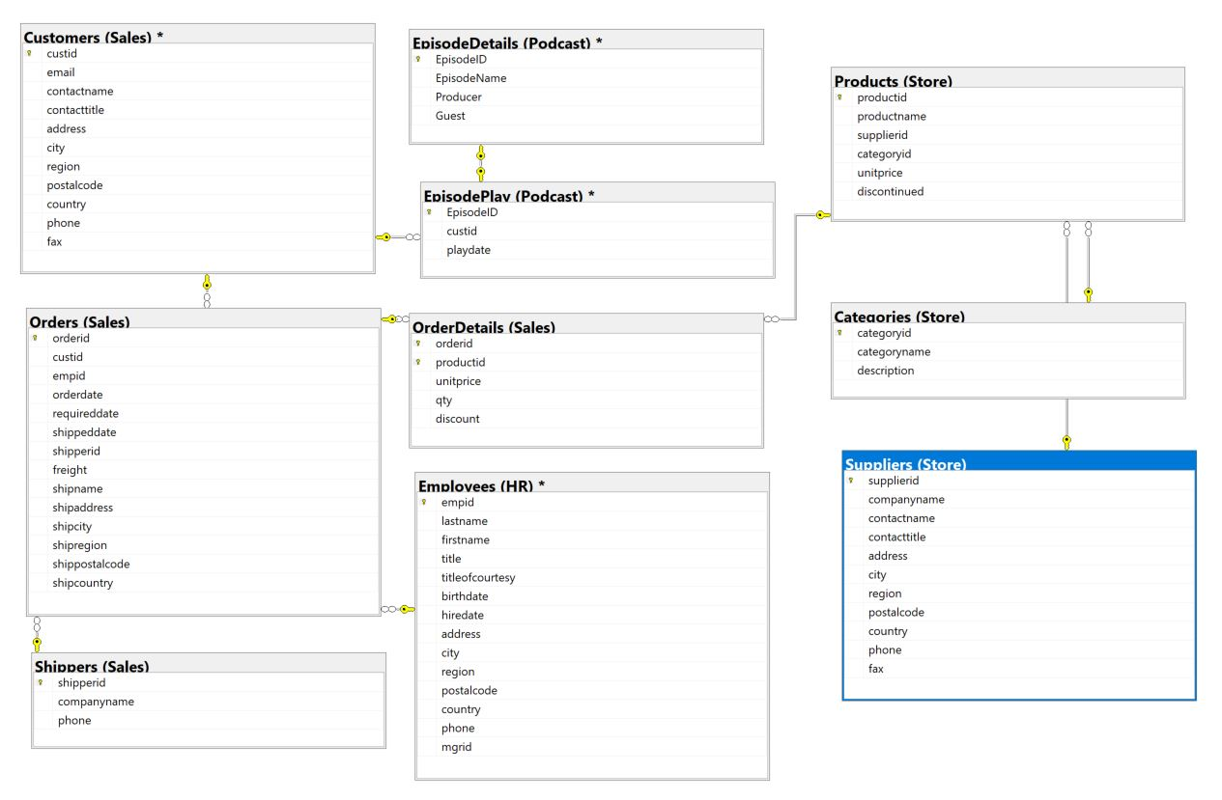
Database DESIGN
I decided to model the TSQLV4 database and then tailor it for the podcast
I decided to keep all of the TSQLV4 tables even though some weren’t in my original information architecture
I added two tables: EpisodeDetails and EpisodePlay
EpisodeDetails lists all of the information for each episode
EpisodePlay gets updated every time a listener plays an episode

Slide 10
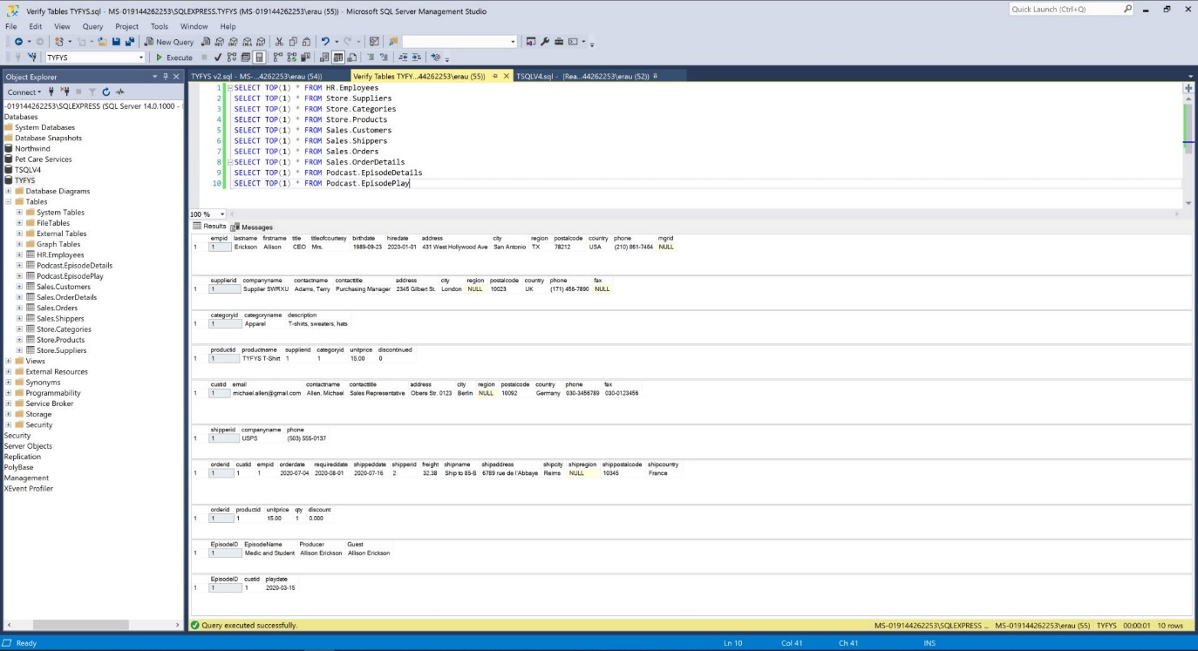
DATABASE IMPLEMENTATION
I populated all of the tables with sample data in order to test the database
My biggest challenge was updating table details since primary keys were assigned
For example, in EpisodeDetails I used varchar(10) for the podcast name.
But the first episode’s name contained 29 characters
I found it was easier to edit the tables using the GUI in Object Explorer rather than updating my original code

Slide 11
questions

